Slide 1

Agile Thoughts (Continued)
Dr. Ram Arthanari

Slide 2

The Agile Manifesto

Slide 3
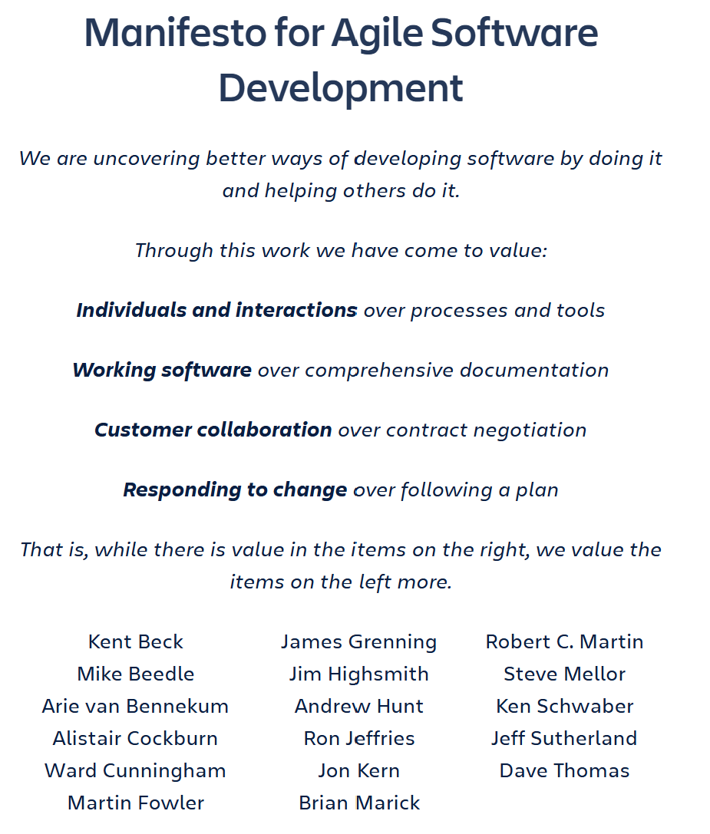
2001 – Snowbird, Utah 17 People Met

Slide 4
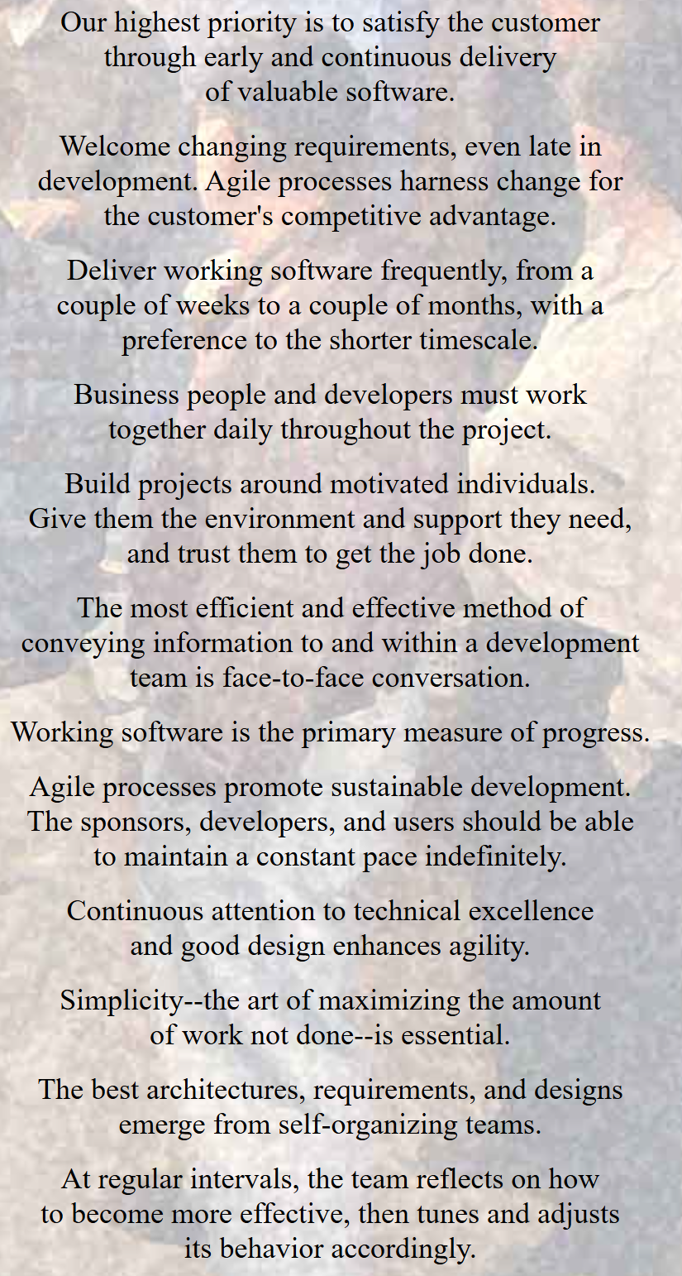
12 Agile Principles

Slide 5
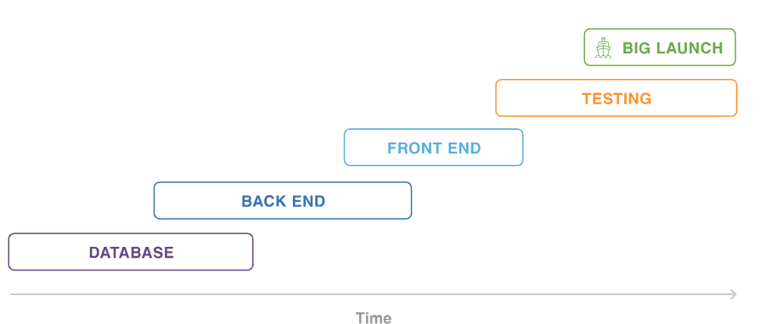
Waterfall Projects
(Atlassian)

Slide 6
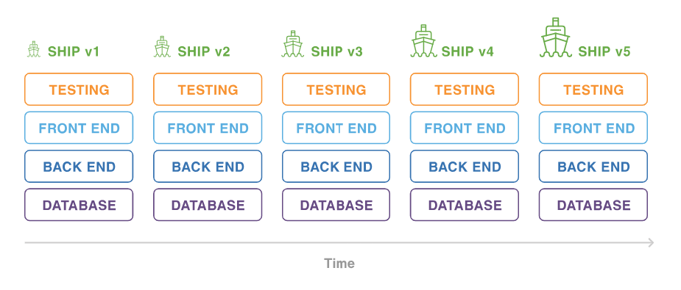
More Resilient to Change (Atlassian)

Slide 7
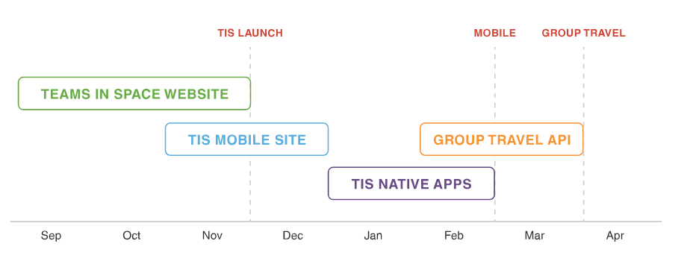
Product Roadmap

Slide 8
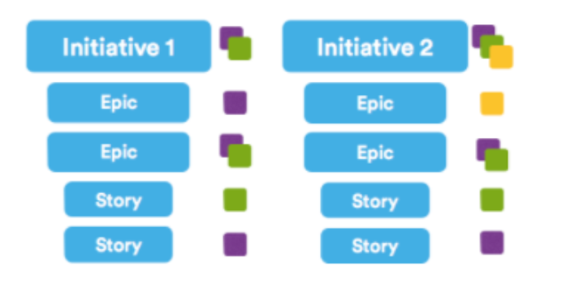
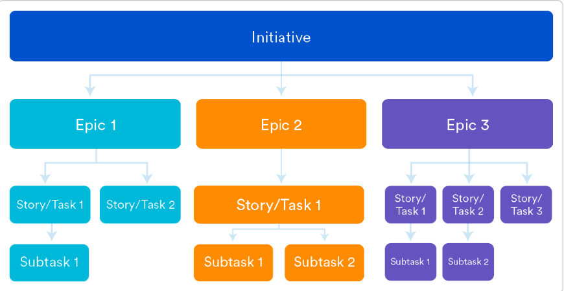
Initiatives, Epics, User Stories

Slide 9
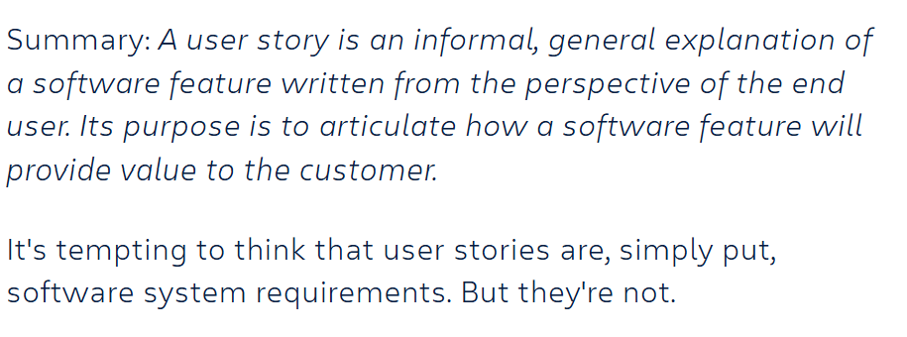
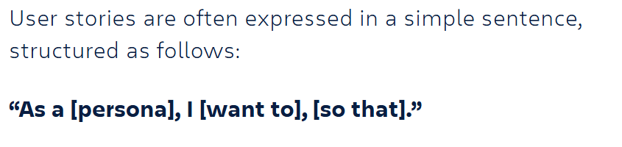
A User Story (Atlassian)

Slide 10
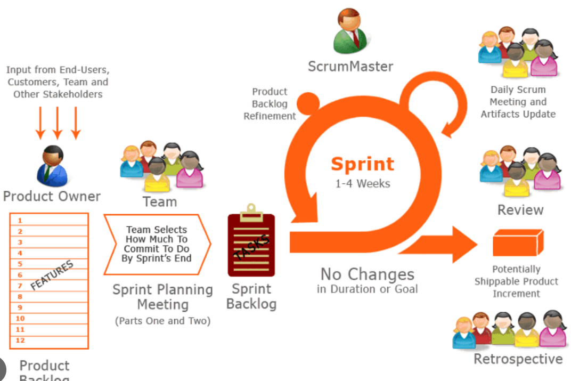
Typical Agile Rituals/
Activities

Slide 11
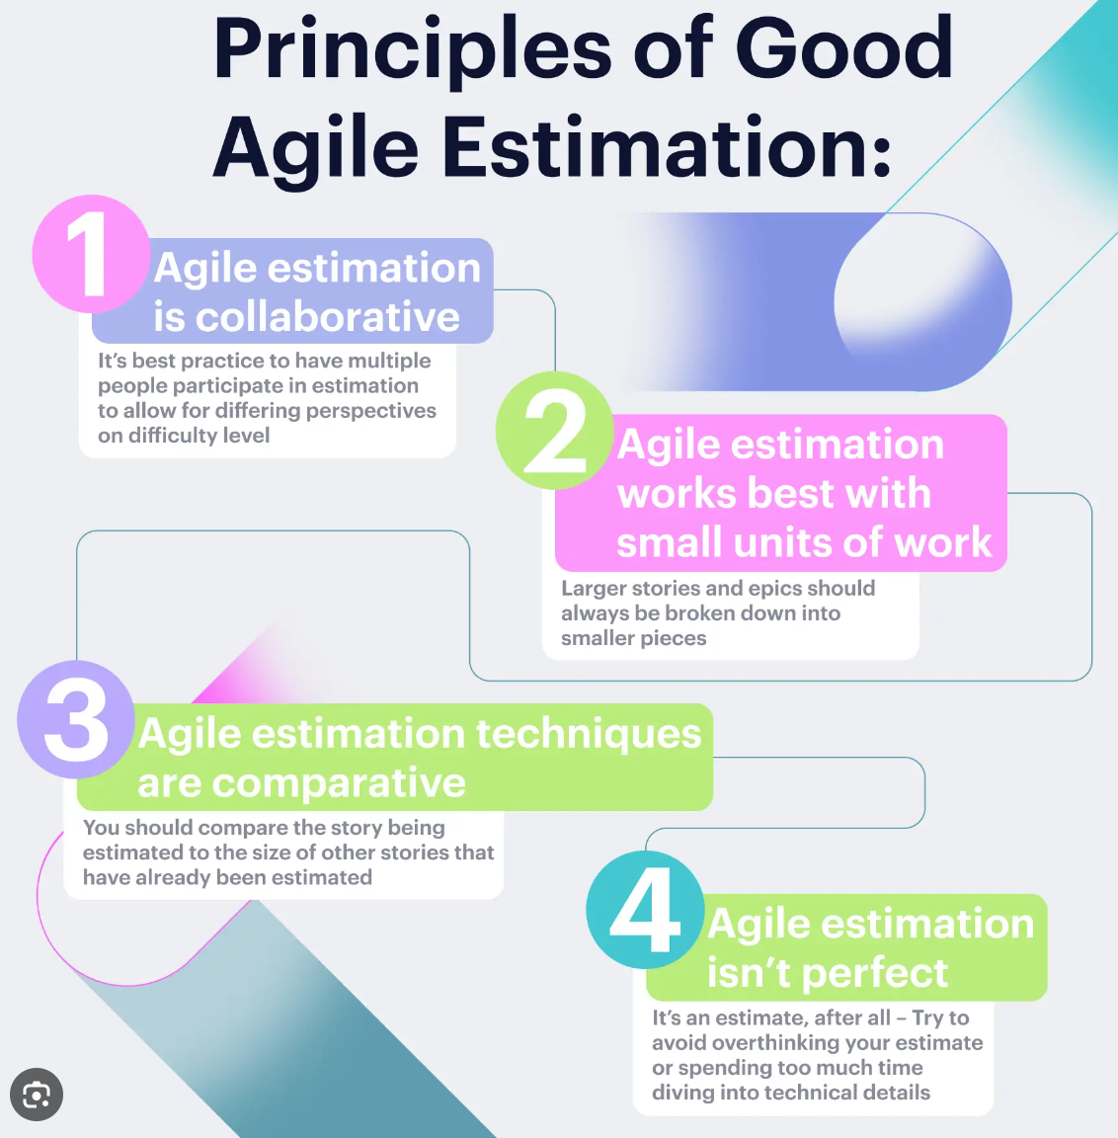
Good Agile Estimation Principles (ZenHub)

Slide 12
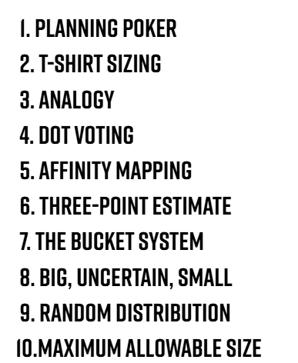
Popular Agile Estimation Techniques

Slide 13
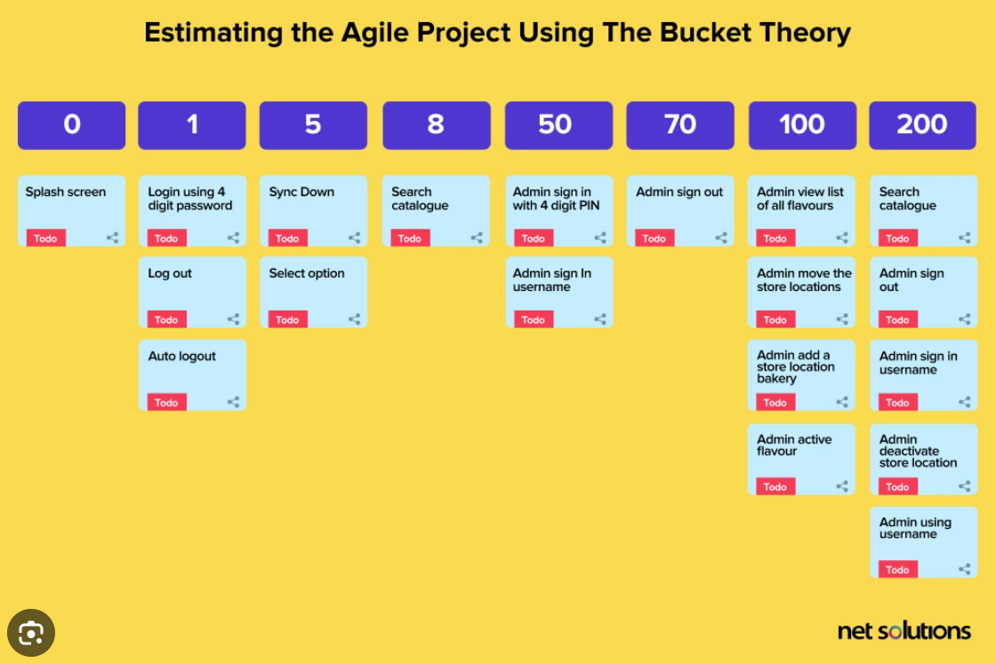
Using Bucket Theory

Slide 14
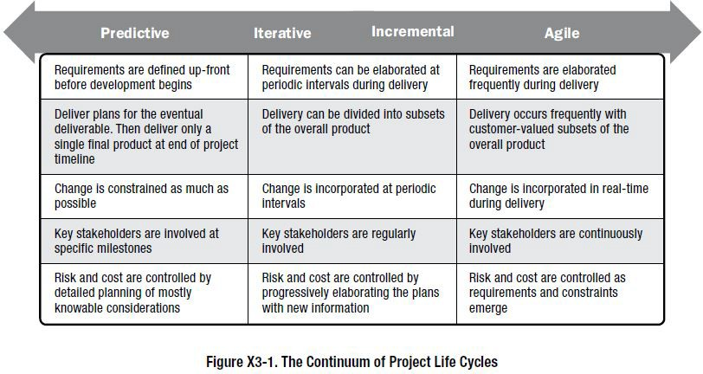
The Continuum of Project Life Cycles
Source: Project Management Institute (2017) A Guide to the Project Management Body of Knowledge (PMBoK Guide) 6th Edition,
Appendix X3: Agile, Iterative, Adaptive, And Hybrid Project Environments
© Susan Gasson 2022 - 4

Slide 15
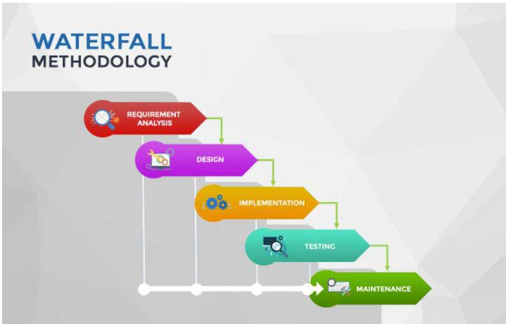
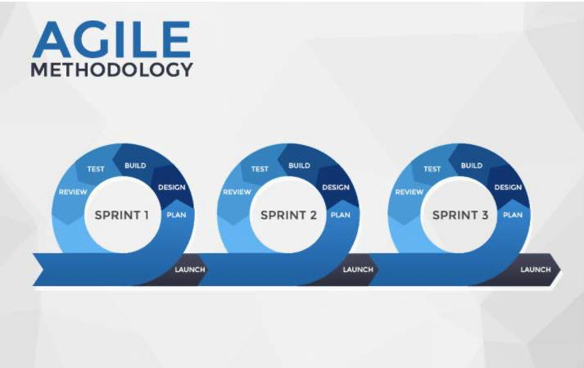
Waterfall Vs. Agile
In waterfall development, we make decisions during development – in requirements definition, design, implementation, and testing – that later prove to be the wrong choice
  So we need a change control process to manage formal requirements
  Then we still spend ≈70% of IT budget on maintenance, fixing things
In agile development, we are confronted with the consequences of our decisions as we develop additional features and evolve the system to fit with what we know now
  With agile, we can fix things as we go along – we don’t need change control – and we get a better system (fewer $$ on maintenance)
  We also get more frequent interactions with stakeholders, so we get to understand when we have misinterpreted requirements!
Source: https://blog.bydrec.com/a-comprehensive-comparison-between-the-agile-scrum-and-waterfall-methodology
© Susan Gasson 2022 - 5

Slide 16
Traditional Vs. Agile Project Emphasis
 | Waterfall/Traditional Project Delivery | Agile Project Delivery
Software devt. process | The development process is divided into distinct sequential phases | The development process is broken down into rapid (two to four- week) cycles
Planning approach | Predictive planning is used, based on a work- breakdown structure defined around system components or functional requirements | Progressive elaboration is employed, based on a feature- breakdown structure. This allows us to fill in details of requirements as they emerge (see rolling wave planning, below)
Project scope | The scope is defined in advance | Scope changes are expected and allowed during the development
Changes to scope | Changes are usually limited, and managed through a formal change management process | Changes are integrated into the process – backlog items are (re)prioritized at the start of each cycle. This means some items will not be completed, which may present problems over time
Client involvement | Requires clients to be available at milestones for deliverables acceptance | Requires client and user participation throughout the project – this may be a problem if client is busy or project sponsor does not agree this with user managers
Feature & function prioritization | Features are prioritized at the start of a project by means of a WBS decomposition & dependencies | Features are prioritized at the Project Scope stage, by defining Epics and Themes that need to be implemented, and in what order (to deliver business value). These are decomposed using a feature-decomposition approach to the work-breakdown structure, at the start of each sprint, when issues are prioritized according to client & user needs
Focus and mindset | Project mindset. The focus is on delivering scope, on time, and to budget | Product mindset. The focus is on delivering value for the customer, whatever that turns out to mean
Quality assurance | Software testing follows software devt. | Testing is performed in parallel with the development
Budget model | Risks are lower with Fixed Price quote | Works well with Time & Materials bid

Slide 17
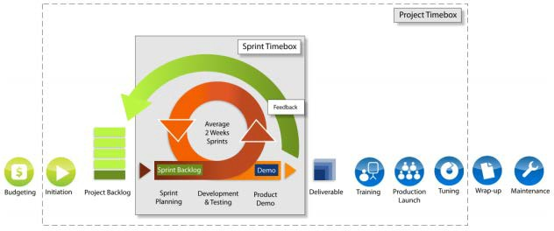
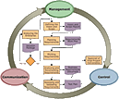

An Agile PMLC Develops Systems in Rapid Increments
Agile development approaches need an initial business problem-analysis, system solution scoping, and project planning/budget phase (just like our traditional project)
⯈ This generates a feature-set (requirements defined as features or use-cases) that are agreed with the client, then stored, in priority order, in the project backlog
⯈ Each Cycle of task-planning, development & testing, and client evaluation (here called a Sprint) develops the highest priority features and integrates these into a working prototype system
⯈ Once all features have been developed, an agile project follows the same type of implementation processes as a traditional project
Version Timebox
Build Cycle
Timebox
4 weeks
average
cycles
Features to be developed this cycle
Business Analysis
System scoping
Version Plan
a.k.a.
Scope Bank
Diagram adapted from: Jumar Solutions Limited (2010), Agile Automated Whitepaper, http://www.jumar-solutions.com/white-papers/agile-automated-whitepaper

Slide 18
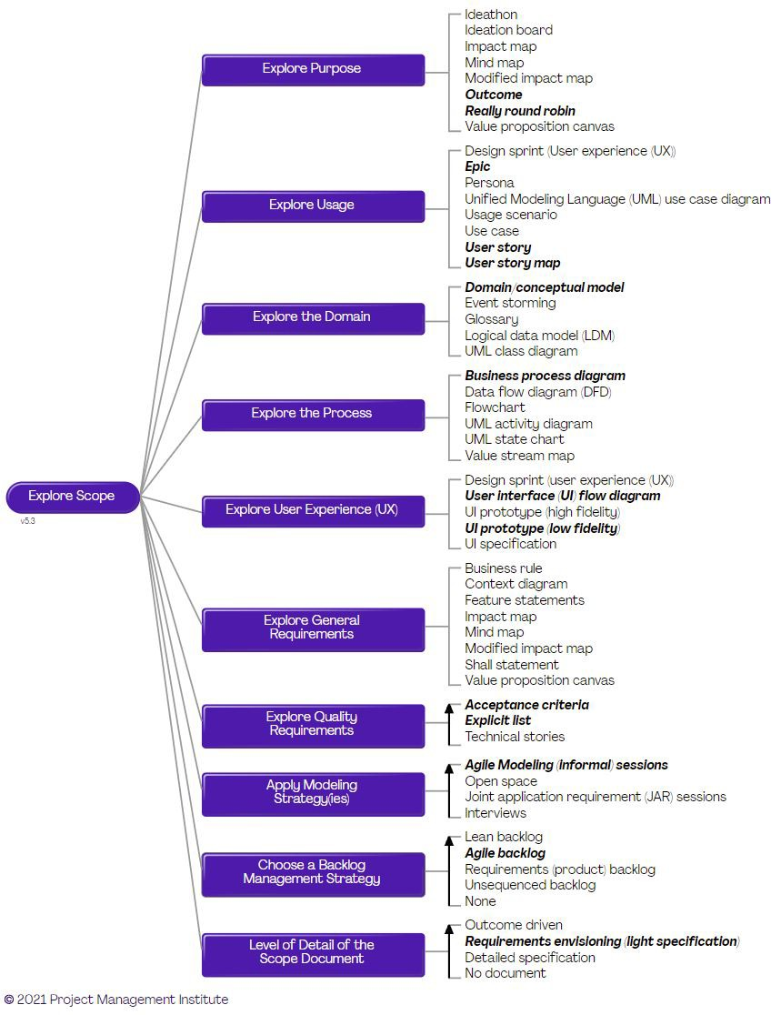
Exploring Scope
There are several reasons why we need explore the initial scope in detail:
🞂
We need to answer common stakeholder questions. Before providing funding for the rest of the effort, our stakeholders are likely to ask us fundamental questions such as: What are you going to deliver? How much will it cost? and When will you deliver it? To answer these questions we will need to work through what we believe the initial scope of our next release will be.
We need to know what to work on initially. You want to do just enough requirements elicitation to understand what our stakeholders want so that we can confidently begin Construction.
We want to set reasonable expectations as to what we’ll deliver. Both the team and your stakeholders need to come to an agreement around a reasonable scope for the current effort that is being funded so that you’re all working towards the same vision.
🞂
🞂
Key Points
🞂
We need to do just enough requirements exploration so that we understand what we’re trying to achieve as a team.
User stories and epics often need to be supplemented with other models to explore domain, user experience, and business process concerns.
You should have a strategy to agree upon and manage quality requirements.
Consider what techniques and tools you will need to prioritize and manage your work.
🞂
🞂
🞂
From <https://www.pmi.org/disciplined-agile/inception-goals/explore-initial-scope>
© Susan Gasson 2022 - 8

Slide 19
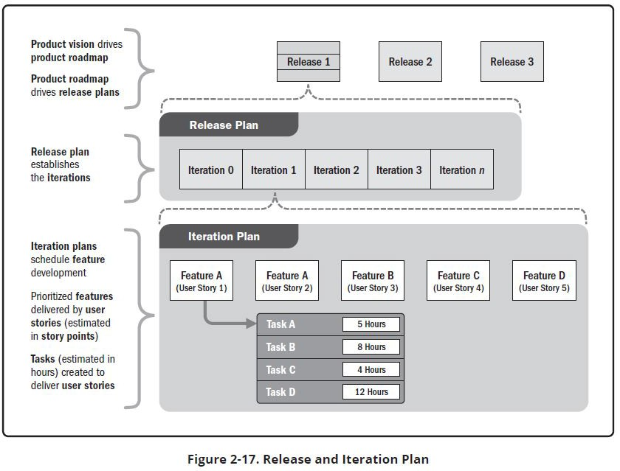
Adaptive Planning
Adaptive schedule planning uses incremental planning:
A typical scheduling & estimation approach is shown in Fig 2-17
A high-level release plan is developed that indicates the basic features and functionality to be included in each release.
Within each release, there will be two or more iterations. Each iteration adds business and/or stakeholder value. Value may include features, risk reduction, experimentation, or other ways of delivering or protecting value.
Planning for the work in future releases is kept at a high level so the project team does not engage in planning that could change based on feedback from earlier releases.
Source: Project Management Institute (2017) A Guide to the Project Management Body of Knowledge (PMBoK Guide) 7th Edition
© Susan Gasson 2022
© Susan Gasson 2022 - 9

Slide 20









Defining Scope With an Agile Project Management Life-Cycle
Scope Release
Goals & Plan Product Roadmap (Cycle Plan)
Business (Problem) Requirements Analysis
Explore user needs
⭢ develop user stories
Decompose stories into product backlog items
Explore dependencies; Design backlog item
Build selected backlog items
Test Against Fit Criteria
Integrate Into System Prototype
Evaluate Prototype Against Client Needs; Reprioritize Backlog
IT System (Solution) Reqs. Analysis
Explore use-scenarios and define software product functionality required to deliver the feature in the way that the user needs
Software Reqs. Analysis
Software Design
Software Component Code & Test (Implementation)
(Increment) cycles iterate around design, implementation & integration of software to meet User-Story/Feature
requirements. Addresses question of “How do we implement
product features to meet the expected client value?”
Software Unit Test
Integration Testing
(Sprint) Cycles: Need to iterate around system requirements, to ask “what do we implement next?”
This revisits system solution definition (user features/stories & business value) plus backlog priorities.
(User/Client) System Evaluation
(Release cycles) we iterate around problem definition requirements, to ask “what are our business requirements now?” We explore business stakeholder needs & business value delivery to (re)define the system vision (version deliverables).
Deliver To Client
Release Delivery

Slide 21
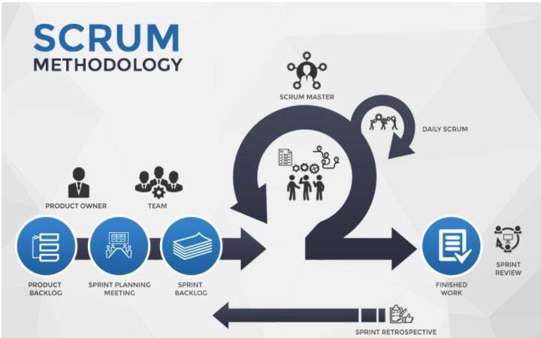
Generic Agile Vs. SCRUM
In agile development, we iterate around the stages of planning, design, build/code, test, & review the product
  We still need an overall plan – so we still need to scope the system (define product roadmap & initial requirements)
  But requirements can evolve as we proceed with the project – change is accommodated as we redefine requirements
SCRUM is defined by a specific set of processes and team roles, that ensure consistency across projects
  Scrum processes are often treated as rituals or ceremonies – these bind the team together through shared culture
Source: https://blog.bydrec.com/a-comprehensive-comparison-between-the-agile-scrum-and-waterfall-methodology

Slide 22

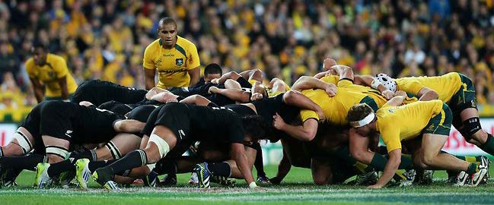
Agile PMLC Approaches – SCRUM
The name SCRUM comes from the British game of Rugby football – shown here is a Rugby Scrummage (or Scrum for short)

Slide 23


Slide 24
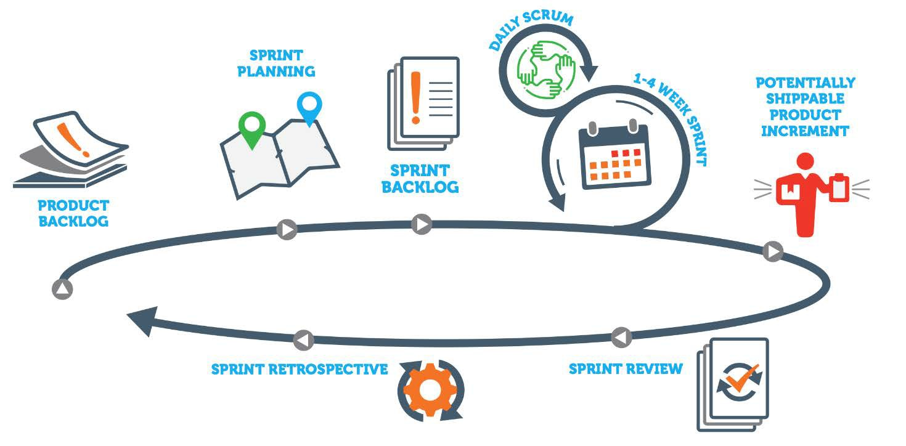
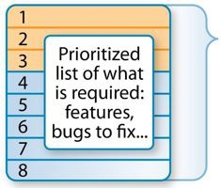
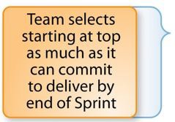



SCRUM Process
Product owner & client provide feedback on product increment
Retrospective Focus:
What went well?
What could be improved?
What went badly?
Backlog priorities for next period/sprint/Epic
SCRUM has three key metrics:
Velocity
Meeting the sprint goal
Forecasted vs. actual work done within the Sprint
Source: https://resources.scrumalliance.org/Article/how-scrum-scrum-teams-work

Slide 25




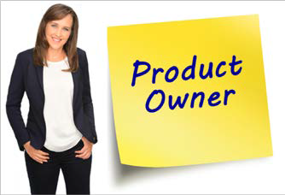
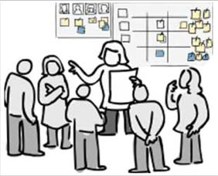




Roles and Responsibilities of a Successful Scrum Team
The Development Team are the designers and problem-solvers. Task allocation and distribution is determined by the Development Team.
Team members include developers from a variety of specialisms, who all work together to deliver the product.
The Scrum Master is a combination of coach, facilitator, and remover of impediments to progress for the Development Team.
The Scrum Master holds a
brief meeting everyday to assess progress of the Development Team and provides the conditions to reach the Sprint goal.
Business Owner or
Program Office
The Product Owner ensures the Development Team is working toward the appropriate targets from a business perspective.
The Scrum Team consists of the Development Team, Product Owner, and Scrum
Master.
All members are responsible for delivery of a complete product.
Other people are involved in meetings, at the discretion of the Product Owner
Each team member plays a specific, well defined, role, at the same time holding each other accountable for shared outcomes of the project and its business value.

Slide 26
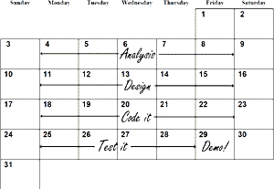
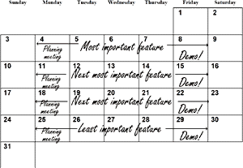
Feature-Led Development 🢧 A Change in Mindset
Traditional approaches analyze all of the requirements (system functions), then schedule development tasks (design, code & test) to deliver those functions
Feature-led development approaches elicit features for a system component, then develops each one separately in consultation with the user or client, to understand the low-level functions required
During consultation, feature-definitions may evolve or change, as the client/user explores their use and their support for work-goals
Features are expressed as user-stories that define:
what the user wants to do (operations)
how they want to do it (steps & interactions)
what criteria will make the feature fit-for-purpose (fit criteria)

Slide 27

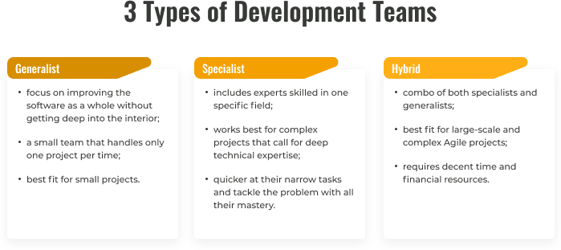
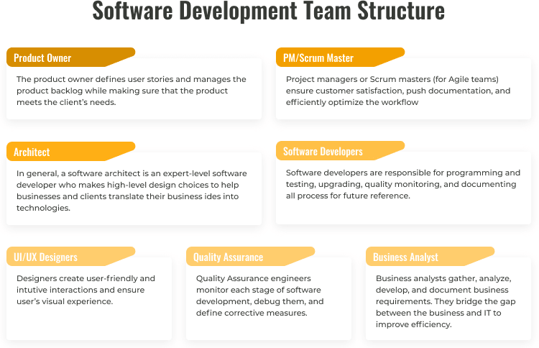
Source: https://dev.to/lanars_inc/what-an-agile-software-development-team-structure-looks-like-5h8i
© Susan Gasson 2022 - 15

Slide 28
Agile Planning as Navigation
Roadmaps
A roadmap outlines how a product or solution develops over time. Roadmaps are composed of initiatives, which are large areas of functionality, and include timelines that communicate when a feature will be available. As the program develops, it's accepted that the roadmap will change–sometimes subtly, sometimes broadly. The goal is to keep the roadmap focused on current market conditions and long-term goals.
Requirements
Each initiative in the roadmap breaks down into a set of requirements. Agile requirements are lightweight descriptions of required functionality, rather than the 100-page documents associated with traditional projects. They evolve over time and capitalize on the team's shared understanding of the customer and the desired product. Agile requirements remain lean while everyone on the team develops a shared understanding via ongoing conversation and collaboration. Only when implementation is about to begin are they are fleshed out with full details.
Backlog
The backlog sets the priorities for the agile program.
  The team (including product owner, user representatives, UX designers, software developers) includes all work items in the backlog: new features, bugs, enhancements, technical or architectural tasks, etc.
  The product owner prioritizes the work on the backlog for the team.
  The development team then uses the prioritized backlog as its single source for what work needs to be done.
Source: https://www.atlassian.com/agile/project-management/program

Slide 29

Rolling-wave planning: we decompose near-term activities down to the detail needed to develop those features, but only plan for future activities at a high level (as we may change direction in the meantime and never implement these features)
Developing an agile roadmap is like navigating a path through misty mountains …
… You can (more or less) see the way through to the second ridge
But then you think there may be a sudden drop or valley hidden behind that ridge …
… You know you want to include the temple on the third ridge in your “user journey” but you’re not sure how to get to it
After that, all bets are off – you can see the landscape outline, but no landmarks are clear enough to plan for …
… However, by the time you reach the temple on the third ridge, you’ll be able to see the next few ridges and plan from there
So you plan the first few parts in detail, then just identify interim objectives that allow you to estimate the time and effort needed to reach the lake in the distance.
© Susan Gasson 2022 - 18

Slide 30


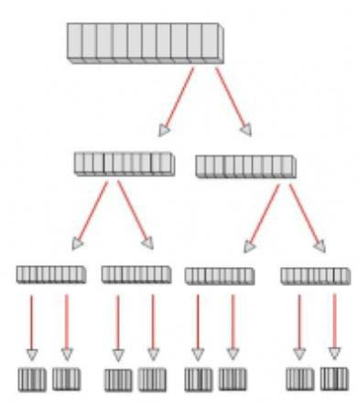


Agile Project Features are decomposed to provide backlog items
So we derive a feature-based work-breakdown structure:
Epics
Features
Equivalent of WBS – Each item in backlog reflects a deliverable that can be completed in one build cycle
The agile WBS is also known as a Value Breakdown Structure, as each deliverable should deliver measurable value to the client
Stories
Functional Requirements
⭢ Devt. Tasks
Unless we need to explore technical dependencies, functional requirements & development tasks are not defined until we start on iteration cycle planning

Slide 31

Agile – The Agile Practice Guide

Slide 32
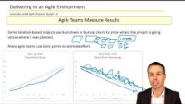
Delivering in an Agile Environment

Slide 33
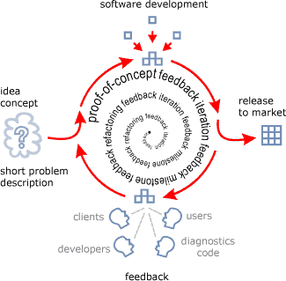
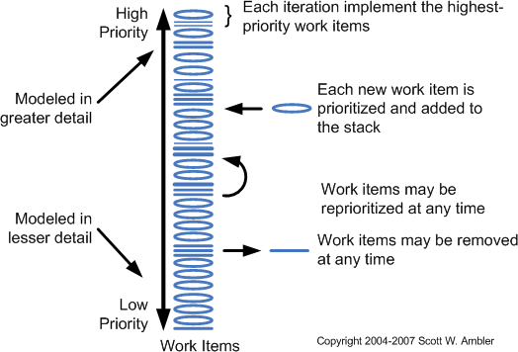
Iterations are planned around the backlog
BACKLOG (SCOPE BANK)
but are usually prioritized & modified (added, removed, updated)as part of the cycle-planning activity at the start of a cycle – or the end of the previous cycle
Feature Backlog List
The backlog is reprioritized at the planning meeting for each cycle, to represent the client’s current priorities (having seen the previous cycle’s prototype)
All features developed come from the backlog
If isn't a user story (a functional requirement, an external regulation, a defect fix, etc.) it still goes in the backlog
“If a story isn’t in the backlog, it ain’t gonna happen.”
Diagrams from Dynamic Ventures Inc. http://www.dyve.com/dv/methodology.htm and http://www.agilemodeling.com/essays/changeManagement.htm

Slide 34



^{Stories, E}to^{p}Ta^{i}s^{c}k^{s}s –, d^{I}e^{n}co^{i}m^{ti}pªos^{t}in^{iv}g R^{e}e^{s}qu,irªem^{n}en^{d}ts ^{T}int^{h}o ^{e}Re^{m}leas^{e}es^{s†}
A collection of Features that enables the Business to accomplish a mission and fulfill a vision.
A Business Capability describes what the business does, not
how it does it.
Example:
Improve Streaming Service for Mobile App. Launch
EPIC or Feature-Set
Examples:
iPhone users need access to a vertical view of the live feed when using the mobile app.
Desktop users need a view fullscreen button in lower right hand corner of video player.
Android users need to be linked to Apple store.
The functionality needed to implement an Capability, typically 2 to 4 weeks in duration. Features are contained within Release. Ideally Features contained within a single team.
Features are what the Product Owner cares about.
(High-Level) FEATURE
A small increment of delivered Value, typically less than a week’s work. Use Stories contained within the Sprint.
These are outcomes the Development Teams cares about.
Features may be defined at story-level, or they may be defined at a higher level and decomposed into stories.
Examples:
As a desktop user, I can see a view fullscreen button in lower right hand corner of video player.
As a desktop user, I can click on the view fullscreen button and see it change color to reflect selection.
As a desktop user, when I select the view fullscreen button, the video player switches to fullscreen mode.
STORY
or Low-Level Feature
Initiatives are collections of epics that drive toward a common goal. Themes are large focus areas that span the organization.
Source: “Agile Requirements Decomposition ‒ Epic to User Story and Story Mapping,” Rick Austin, Duluth Georgia, Enterprise Agile Coach
© Susan Gasson 2022 - 21

Slide 35
How to write Epics
It is good practice to write the Epic before your user stories
The Epic acts as a broad headline for your overall large story
Then you can go into more specific detail with each individual story, defining user features and scenarios
This will help you determine your project’s scope early on while giving yourself time to delve into user research for each requirement at a later stage.
Mike Cohn, a co-founder of the Scrum Alliance, offers more insight into this breakdown process:
“Suppose you ask me if I had time yesterday to write the user stories about the monthly reporting part of the system. ‘Yes,’ I reply, ‘But they are mostly epics.’
That tells you that while I did write them, I didn’t get the chance to break most of them down into stories small enough to implement directly.”
Once you’re ready to create your own Agile epic, use the following steps as a guide:
Outline your user personas
  Who is this project for? Maybe you’re adding a product feature for existing customers or tweaking your onboarding system to attract new users. Create fictional characters for each user story, detailing their pain points and key requirements.
Organize your stories
  Each epic will have a collection of user stories to be delivered. Assign each story to an iteration or sprint, creating a clear project roadmap. This will help you estimate how long your epic will take.
Request feedback
  Seek user feedback throughout various stages of your epic. Listen to suggestions and try to incorporate them into your epic plan. If a user story needs to be tweaked or removed, now is the time to do it.
Source: https://www.wrike.com/agile-guide/agile-epics-guide/
© Susan Gasson 2022 - 22

Slide 36



































Elaboration and Decomposition are Critical
High Level
Medium Level
Low Level
Just in Time Details
Business Rules
Feature
Story
Acceptance Tests
Epic
Story
Activities
Feature
Story
Tasks
UI Mockups
Epic
Provides the ability to accomplish a business goal (deliver VALUE)
Feature
A service needed to deliver the Epic
Story
A conversation about a desired functionality
Scenario
A set of contextual (situation- or user-specific) details that explain how, why, where, and when the desired functionality will be used
Adapted from: “Agile Requirements Decomposition ‒ Epic to User Story and Story Mapping,” Rick Austin, Duluth Georgia, Enterprise Agile Coach
© Susan Gasson 2022 - 23

Slide 37
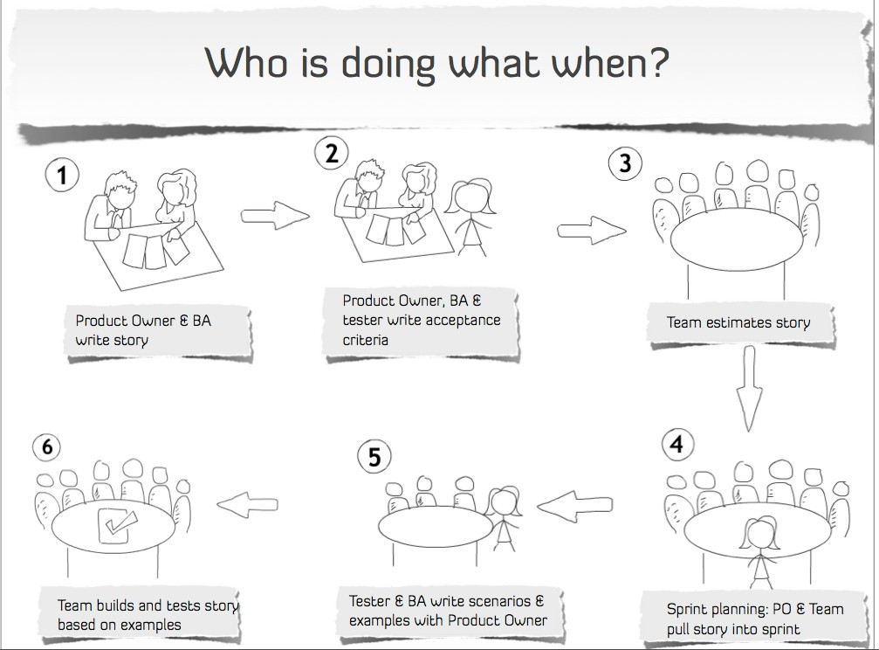
How Features (User Stories) Feed Into The Agile Process

Slide 38
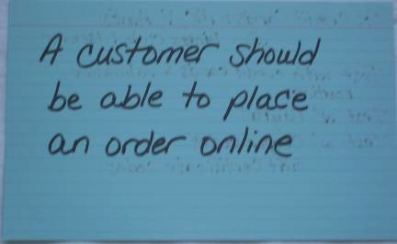

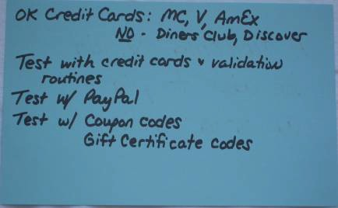
Scope Verification – Via Story Cards
Acceptance criteria for the feature are written on the back of the card. This is the basis for the test cases.
Passing test cases aren’t enough to indicate acceptance – the Product Owner must accept each story.

Slide 39
Example of Elaboration and Decomposition
Business Capabilities Delivered in Epics | Features Delivered in Releases | Stories Delivered in Sprints | Scenarios Explored during Sprints
Capture New User Profile to start the enrollment | Allow New User to Create Profile Allow New User to Maintain Profile | As a New User I want to enter my Profile Information to start an enrollment application I want to control the privacy settings in my profile I want to choose a course to enroll in | A new student who is unfamiliar with the system needs a guided path to set up a user profile An existing user logs into the system to recall their profile details A new student who is unfamiliar with the system needs a guided path to set up a user profile An existing student, who is familiar with how the system works, needs a rapid way of changing privacy settings A new student who is unfamiliar with the system needs a guided walkthrough to identify courses open to them, select one, and then register for the course An existing student, who is familiar with the system, needs shortcuts to course selection, and course registration.
Business Capabilities can be spaced across multiple releases | Features are delivered in a single Release | Stories are delivered in a single Sprint (or broken down into lower-level backlog items) | Scenarios are delivered in a single Sprint (these provide the lower-level backlog items that provide details of the use-case)
Adapted from: “Agile Requirements Decomposition ‒ Epic to User Story and Story Mapping,” Rick Austin, Duluth Georgia, Enterprise Agile Coach
© Susan Gasson 2022 - 26

Slide 40
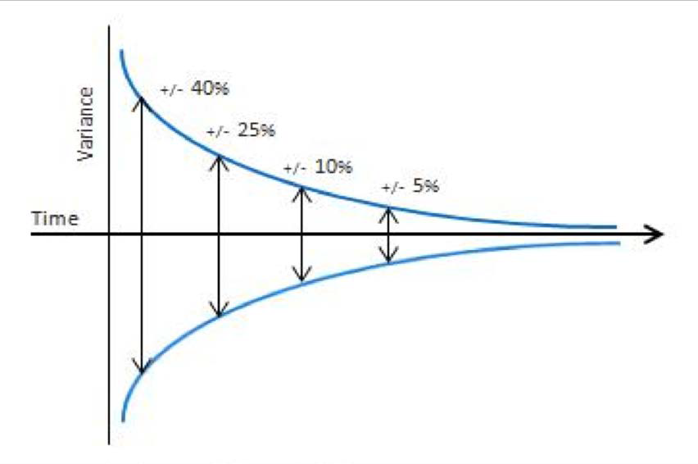
Requirements Estimating Using the Cone of Uncertainty
Rolling-wave planning: we decompose near-term activities down to the detail needed to develop those features, but only plan for future activities at a high level (as we may change direction in the meantime and never implement these features)
Epics and the Capabilities and Features they contain are big ideas but there is usually enough understanding to get some Rough Order of Magnitude estimate
User Stories can be created and refined from the Features with enough details for relative sizing in chunks of hours
Development Tasks created at the planning session before cycle build (development) starts can be estimates in much finer accuracy and precision
Epic
Feature
Story
Task
The Cone of Uncertainty
© Susan Gasson 2022 - 27

Slide 41
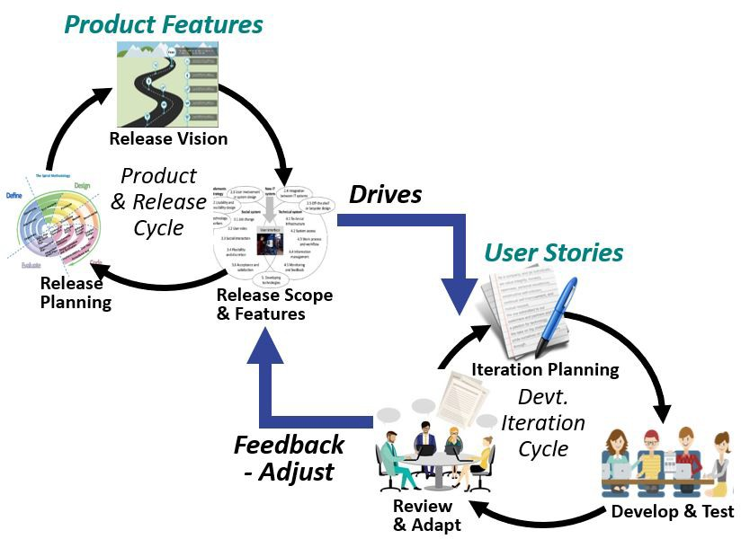
Release-Planning: How Process Elements Fit Together
Release planning drives agile product devt.
Releases (a.k.a. versions) are developed around packages of features that add functionality to the system product
Planned around system increments that may focus on support for new user groups (as with our functional components) or on stability, scalability, or system-wide requirements
The release vision, or roadmap, drives the release scope: what organizational functions are supported, to what extent, and what goals the release accomplishes
Product features are high-level system capabilities that are decomposed into sets of user features (EPICs)
  Each of these is explored as a series of user stories that define low-level features and the acceptance criteria for each feature
  User stories are decomposed into functional requirements that are developed and tested according to acceptance criteria
Slide adapted from: Dean Leffingwell (2010), Scaling Software Agility: Agile Software Requirements, Presented at Agile Denver
© Susan Gasson 2022, slide 28

Slide 42

The primary purpose of software project Planning and Estimating is not to predict a project’s outcome.
It is to determine whether a project’s targets are realistic enough for the project to be controlled to meet these outcomes as planned.
– Steve McConnell

Slide 43
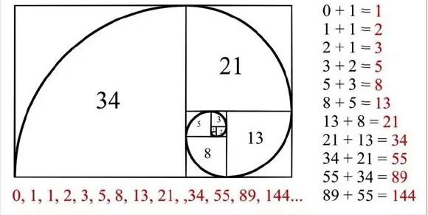
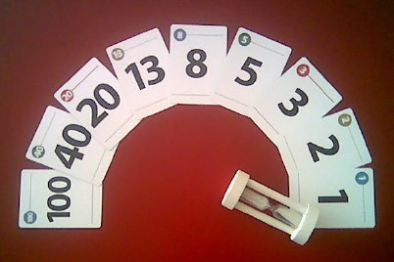
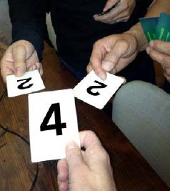
Estimation Techniques When You Have Historical Data or Experience: Planning Poker
The most popular technique for relative estimation is Planning Poker – this uses the Fibonacci number sequence to assign a point value to a feature or item
A mathematical series of numbers introduced in the 13th century that is used to explain aspects of nature, such as the branching of trees
Series is generated by adding the two previous numbers together to get the next value in the sequence: 0, 1, 1, 2, 3, 5, 8, 13, 21, and so on …
For agile estimation purposes, some of the numbers have been changed, resulting in the following series: 1, 2, 3, 5, 8, 13, 20, 40, 100
The Fibonacci series was chosen because each number is different enough from the previous one in the series to make people really think about which estimate “bucket” to place each task into
Team members play “Planning Poker” (see second photo) to provide an estimate in the form of a point value for each item. Here are the steps:
Each team member gets a set of cards.
The business owner (who does NOT get to estimate) presents the item to be estimated.
The item is discussed.
Each team member privately selects a card representing his/her estimate.
When everyone is ready, all selected cards are revealed at the same time.
If all team members selected the same card, then that point value is the estimate.
If the cards are not the same, the team discusses the estimate with emphasis placed on the outlying values:
  The member who selected the lowest value explains why he/she selected the value.
  The member who selected the highest value explains why he/she selected the value.
Select again until estimates converge.
Should lengthy or “in-the-weeds” conversations result, team members may use a two-minute timer to timebox the discussion, selecting again each time the timer runs out, until conversion.
Repeat for each item (Cohn, 2006, pp. 56–57).
Source: Cohn, M. (2006). Agile estimating and planning. Upper Saddle River, NJ: Prentice Hall.

Slide 44

PLANNING POKER
Estimating
Sassy says it’s a 5 Point Story
Bad Penny agrees with Maia
Theo agrees with Sassy
Bailey says it’s a 13 Point Story
Maia says it’s an 8 Point Story
Wiggly agrees with Sassy
Meatloaf says it’s a 20 Point Story
© Susan Gasson 2022 - 31

Slide 45
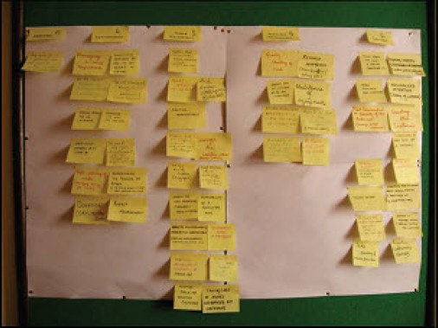
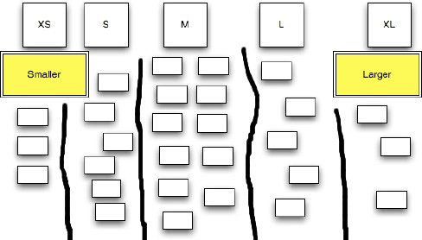
Estimation Techniques When You Have Historical Data/Experience:
Affinity Grouping
Affinity grouping is a faster way to estimate than planning poker, used when the number of items to estimate is large
Team members simply group items together that are like-sized, resulting in configuration similar to the one in the photo below. The method is simple and fast:
  The first item is read to the team members and placed on the wall.
  The second item is read and the team is asked if it is smaller or larger than the first item; placement on the wall corresponds to the team's response (larger is to the right, smaller is to the left).
  The third item is read and the team is asked if it is smaller or larger than the first and/or second items; the item is placed on the wall accordingly.
  Control is then turned over to the team to group the remainder of the items
Teams may continue placing one item at a time on the wall after group discussion OR (faster) have each team member select an item and place it based on their own understanding
  This is done with all team members working in parallel until all items have been assessed and placed on the wall
  Several hundred items can be estimated in a relatively short time
  Once all items are on the wall, the team reviews the groupings
  Items that a team member believes to be in the wrong group are discussed and moved if appropriate
Once affinity grouping is complete, estimation unit values (points) are assigned
  The first set on the far left in the photo would be labeled as having a value of 1 point
  The second set would be 2 points, The third set 3 points, The fourth set 5 points, and The last set 8 points
The last photo shows an example of affinity grouped items labeled with T-shirt sizes instead of points – the unit doesn’t matter; the way of thinking about relative size just has to be helpful
  In the example shown, the T-shirt sizes just help to differentiate between different estimate-ranges
© Susan Gasson 2022 - 32

Slide 46
























Story Points are the de facto standard, but …
… Story Points are measures of relative work effort – not duration or actual cost
Story Points are NOT a measures of the cost of scope
Story Points are Ordinal units of measure – relative measures
Hours are measures of effort as well
Hours also are a measure of Scope:
  From the Feature-breakdown, each deliverable is assigned a relative size
  From the labor rate, that relative size can be converted to hours of effort as well as material costs (for the budget)
Tasks Tasks
Tasks Tasks
User Story
Feature
Tasks
Tasks
User Story
Tasks
Tasks
Epic
Tasks
Tasks
Feature
User Story
Tasks Tasks
Story Points (relative size)
Hours for Stories and Tasks (derived from estimate
for detailed feature breakdown)
© Susan Gasson 2022 - 33

Slide 47


Leveling: Using A Bucket Plan For Releases #1
Bucket Planning is a key part of Agile Project Planning
It assumes each User Story has an estimate
The capacity of a bucket is the expected team productivity for that time period, whether velocity or throughput
When you estimate the features planned for each cycle, your cycle plan will probably look like this:
Cycle 1 Cycle 2 Cycle 3 Cycle 4 Cycle 5 Cycle 6 Cycle 7 Cycle 8 Cycle 9
Bucket Planning with Sprints
The capacity of each Cycle (or Sprint/Iteration/Timebox) is a bucket
The team capacity in a set time period limits how many User Stories can fit
You can put User Stories into any of the buckets but if a bucket is full, you can’t put any more features into it
The Product Owner can’t overfill buckets - they have to move the overflow to another bucket or discard it
In traditional project management this process, of making sure that the team capacity is sufficient to do the work assigned to each time period, is called Levelling.
Source: https://itsadeliverything.com/bucket-planning-helpful-metaphor-for-agile-release-planning

Slide 48



Leveling: Using A Bucket Plan For Releases #2
Your goal in leveling the cycle plan is to have it look like this:
Cycle 1 Cycle 2 Cycle 3 Cycle 4 Cycle 5 Cycle 6 Cycle 7 Cycle 8 Cycle 9
Bucket Planning to Level Sprint Velocity
Estimate cycle 1 (or next cycle) feature duration by using a low-level decomposition (RBS-level) to estimate effort Estimate cycle 2-5 (or successive cycle) duration and effort by comparing to cycle 1:
Number of features to be implemented
Relative complexity (difficulty, risk, effort) of planned features
Estimate cycle 6-N (or far-out cycle) duration and effort by comparing to cycles 2-5:
Estimated number of features in feature-set
Relative complexity (difficulty, risk, effort) of the planned feature-set
Now determine a suitable amount of effort per cycle - in my worked example, each bucket is equivalent to
A team of 5 people, working in 4 week cycles (Sprints), for 5 days/wk, 7 hrs/day = 700 man-hours
- minus 2 days (70 man-hours) allocated for team cycle planning = 630 man-hours
Source: https://itsadeliverything.com/bucket-planning-helpful-metaphor-for-agile-release-planning

